Slide 1
Create Widget
Calvin
2012.03.04

Slide 2
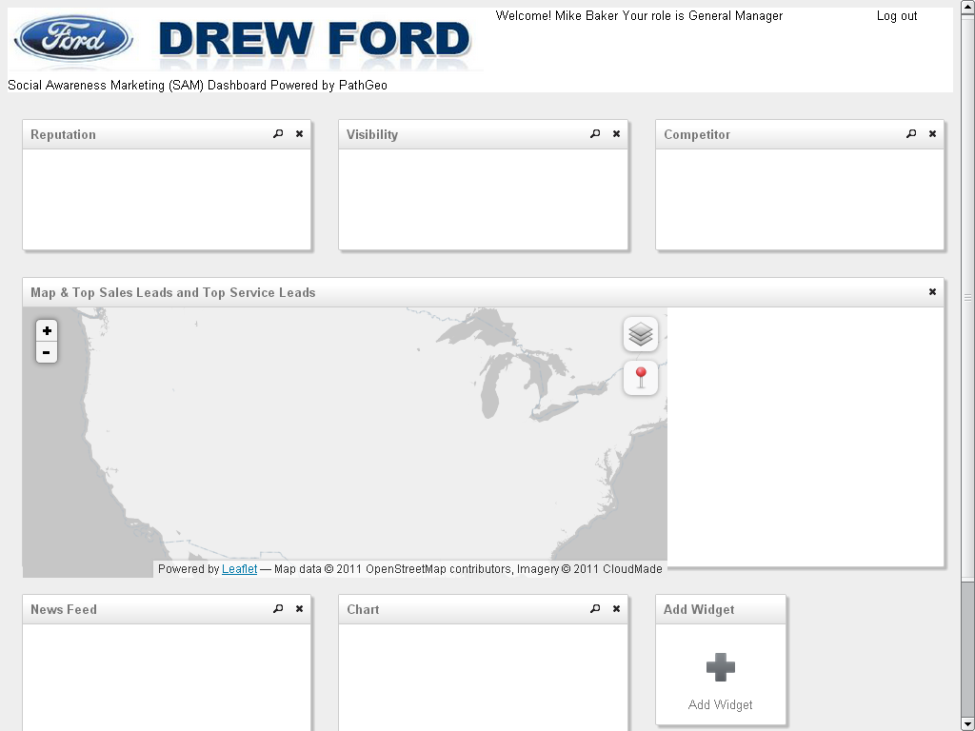
http://vision.sdsu.edu/calvin/demo/
Widget
Widget
Widget
Widget
Widget
Widget
Widget

Slide 3
//Each widget are implemented in DIV
<div
id='widget_map' //widget DOM ID
class='widget' //widget css class
widget-title='Map & Top Sales Leads and Top Service Leads' //widget title
widget-onInit="init_map()" //the function will be called when the widget is ready
widget-onClose="" //the function will be called when the widget is closed
widget-onClick="" //the function will be called when the widget is clicked
widget-sizeX=6 //the widget size X (from 1 to 6)
widget-sizeY=2 //the widget size Y (from 1 to 6)
widget-row=2 //the widget position: row
widget-col=1> //the widget position: column
<div id='map' style='width:70%; height:94%;'></div> //the layout in the widget
<div style='width:30%; height:94%;'></div>
</div>

Slide 4
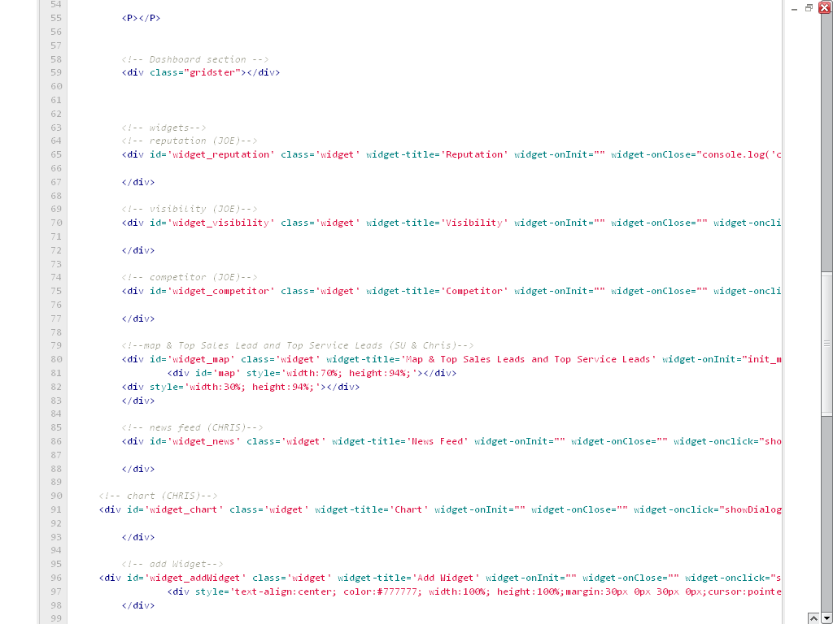

Slide 5
